Slide 1
Conservation of 2D Momentum
Experiment #8
PHYSIC 181 - Spring 2020
Dept. of Physics UMASS Boston

Slide 2
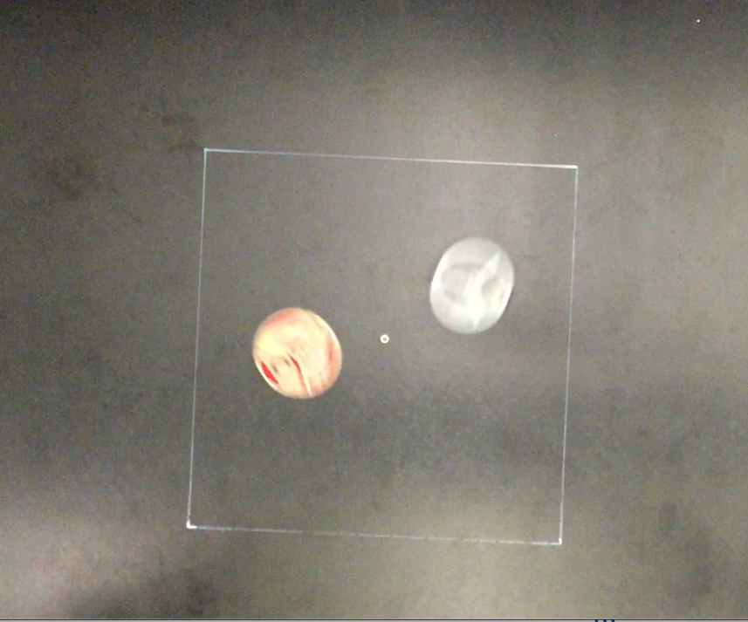
Experimental Overview
Purpose
Compute the total initial and total final momentum of a two-dimensional system
Verify the law of conservation of momentum in elastic collisions
Apparatus
Plastic pucks (2)
Air table
Recording and analysis software
Mass balance
Meter stick

Slide 3
Theory
Polar Coordinates
Cartesian Coordinates
Cartesian vs Polar Coordinates

Slide 4
Theory
Using the Pythagorean theorem, we can convert from Cartesian to polar:

Slide 5
Theory – Adding Vectors

Slide 6
Theory – Adding Vectors

Slide 7
Theory – Adding Vectors

Slide 8
Theory – Adding Vectors

Slide 9
Theory – Adding Vectors

Slide 10
Theory – Adding Vectors

Slide 11
Theory – Adding Vectors

Slide 12
Theory – Adding Vectors

Slide 13
Theory – Adding Vectors

Slide 14
Theory – Adding Vectors

Slide 15
Theory – Adding Vectors

Slide 16
Theory – Adding Vectors

Slide 25
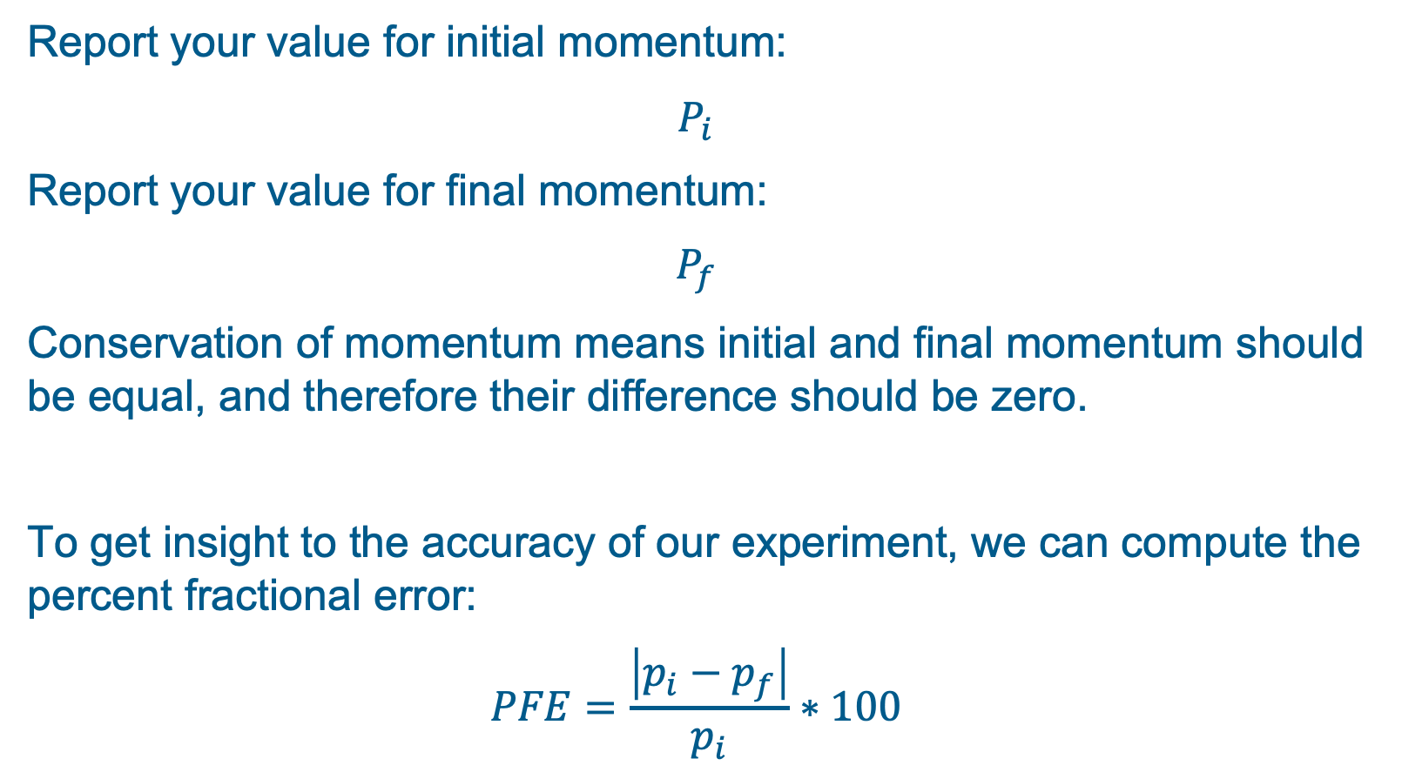
Final Results
Report your value for initial momentum:
$$P_{i}$$
Report your value for final momentum:
$$P_{f}$$
Conservation of momentum means initial and final momentum should be equal, and therefore their difference should be zero.
To get insight to the accuracy of our experiment, we can compute the percent fractional error:
$$PFE=\frac{\left|p_{i}−p_{f}\right|}{p_{i}}∗100$$

